Slide 1
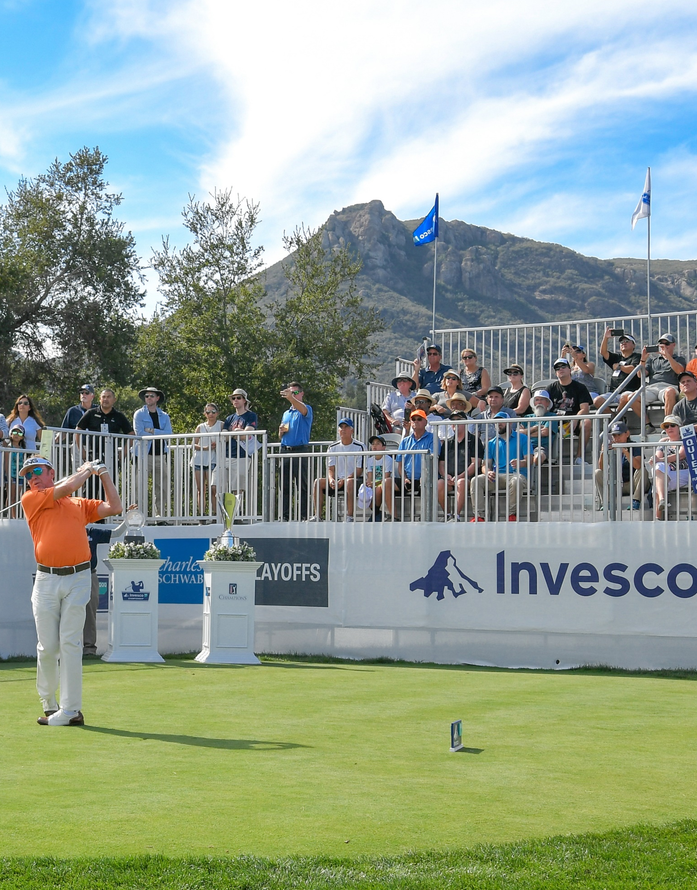



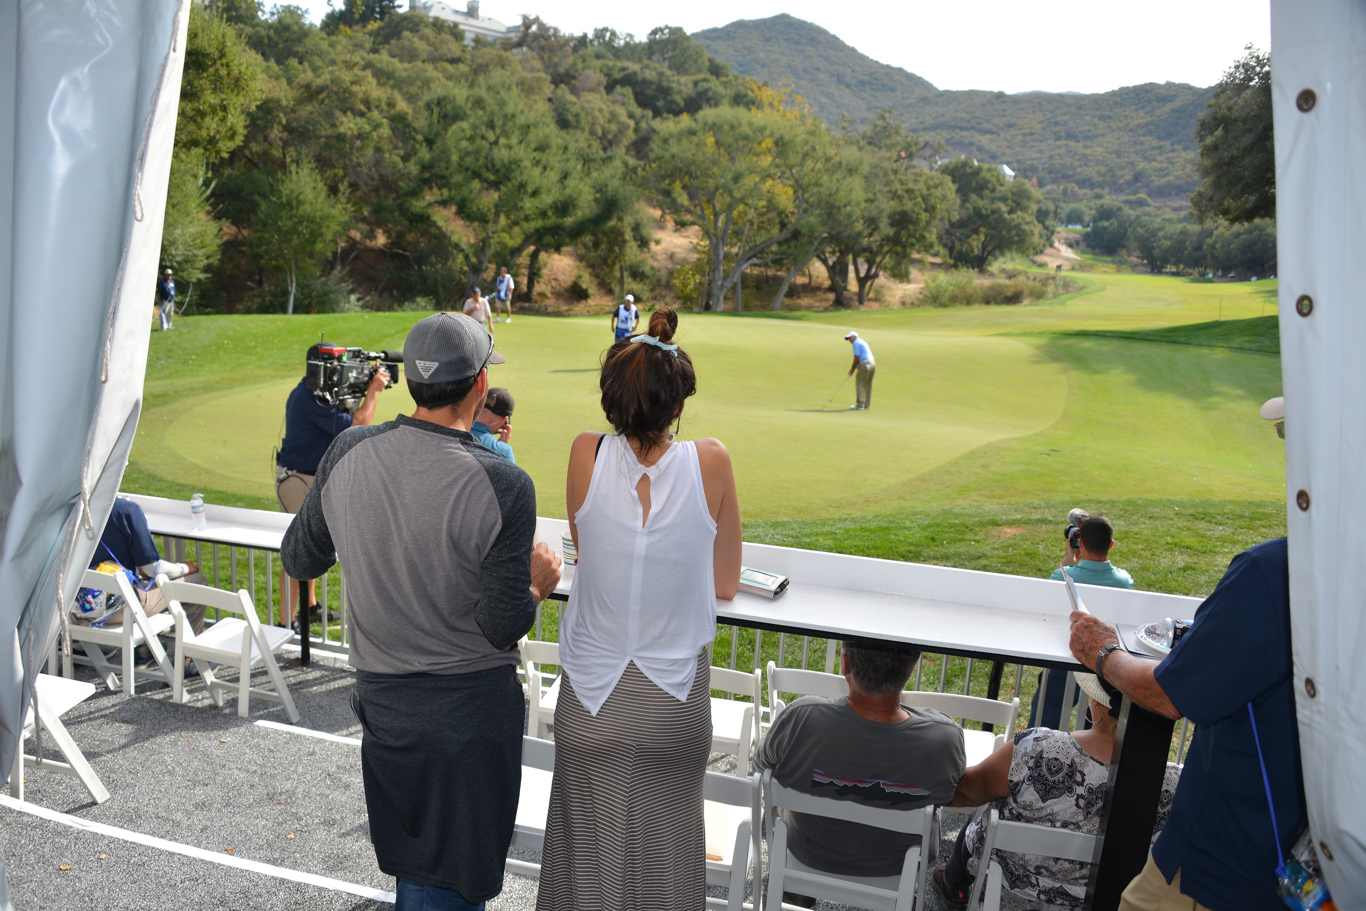
Join Company Name for premier views over 9 Green and access to Sherwood Country Club’s Clubhouse during the
2019 INVESCO QQQ CHAMPIONSHIP
Witness the excitement as legends like Bernhard Langer, John Daly, Vijay Singh, and Fred Couples compete for their spot in the Charles Schwab Cup Finale.
Friday, November 1st
Gates Open 8:00 AM
Championship First Round Begins 8:45 AM
Sherwood Country Club
320 West Stafford Road
Thousand Oaks, CA 91361
Company logo

Slide 2
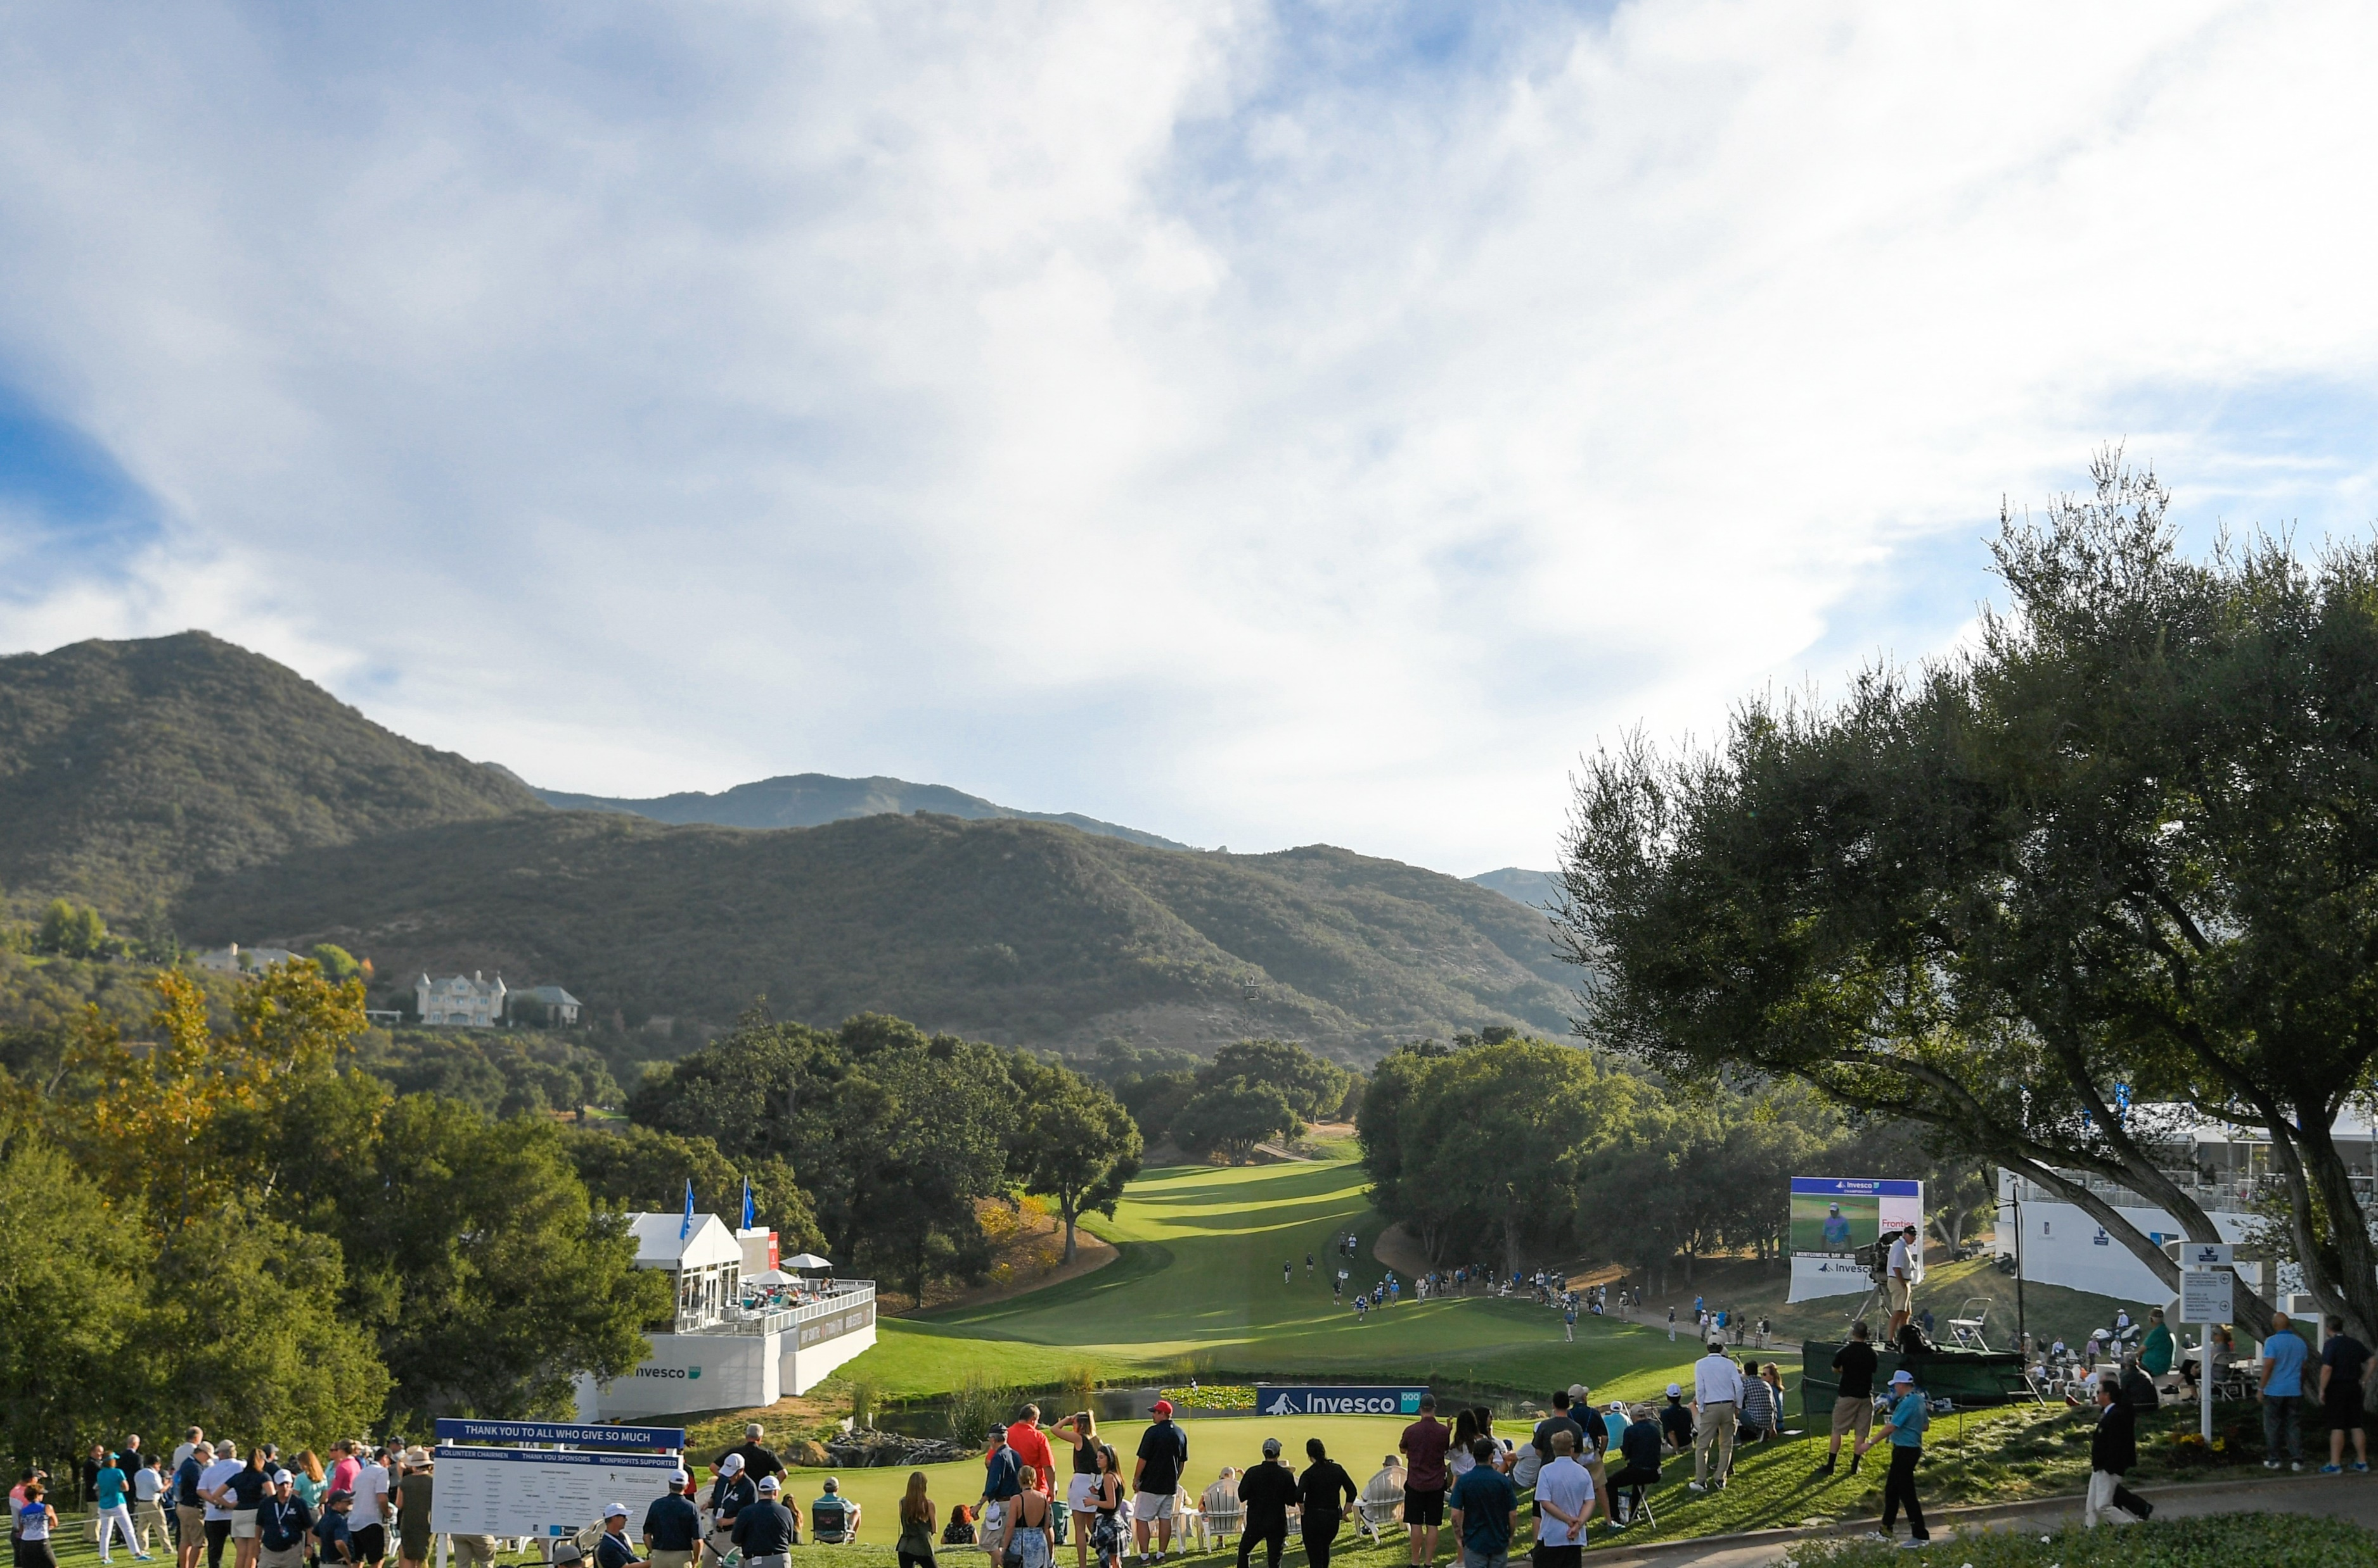
Join Company Name for premier views over 9 Green and access to Sherwood Country Club’s Clubhouse during the
2019 INVESCO QQQ CHAMPIONSHIP
Witness the excitement as legends like Bernhard Langer, John Daly, Vijay Singh, and Fred Couples compete for their spot in the Charles Schwab Cup Finale.
Saturday, November 2nd
Gates Open 8:00 AM
Championship Round 2 Begins 8:45 AM
Sherwood Country Club
320 West Stafford Road
Thousand Oaks, CA 91361
Company logo

Slide 3
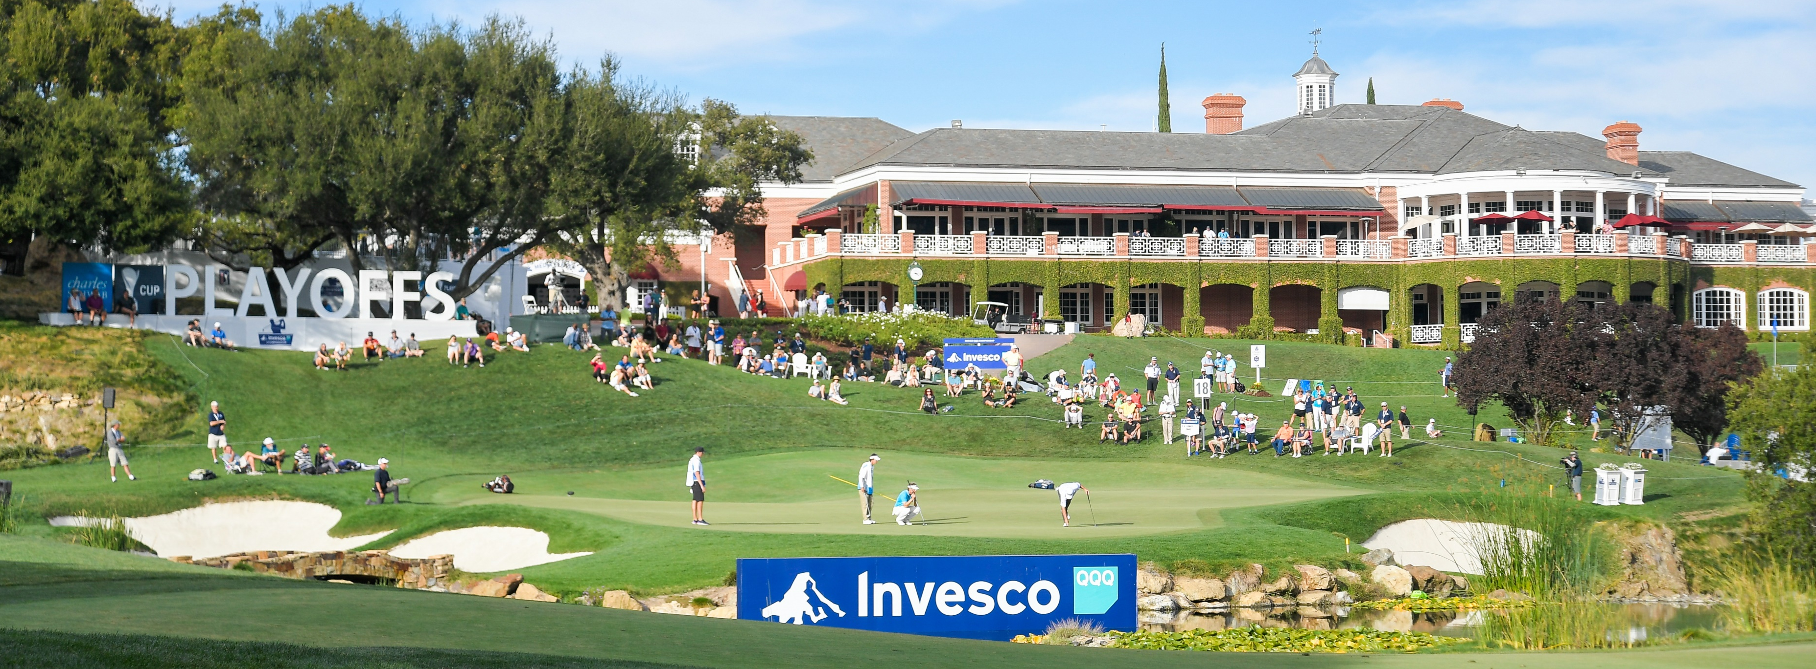
Join Company Name for premier views over 9 Green and access to Sherwood Country Club’s Clubhouse during the
2019 INVESCO QQQ CHAMPIONSHIP
Witness the excitement as legends like Bernhard Langer, John Daly, Vijay Singh, and Fred Couples compete for their spot in the Charles Schwab Cup Finale.
Sunday, November 3rd
Gates Open 7:00 AM
Championship Final Round Begins 7:45 AM
Sherwood Country Club
320 West Stafford Road
Thousand Oaks, CA 91361
Company logo

